Slide 1
Impromptu Speaking
When one is given a prompt, desired time for preparation, and then delivers a speech or debate with a desired time limit.

Slide 2
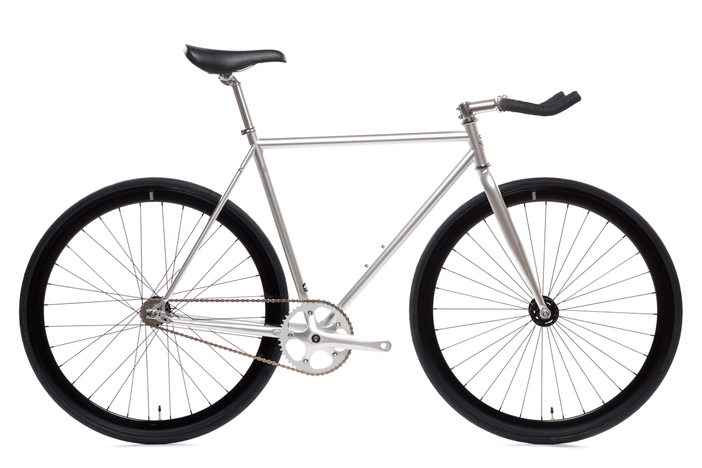
Bicycle

Slide 3
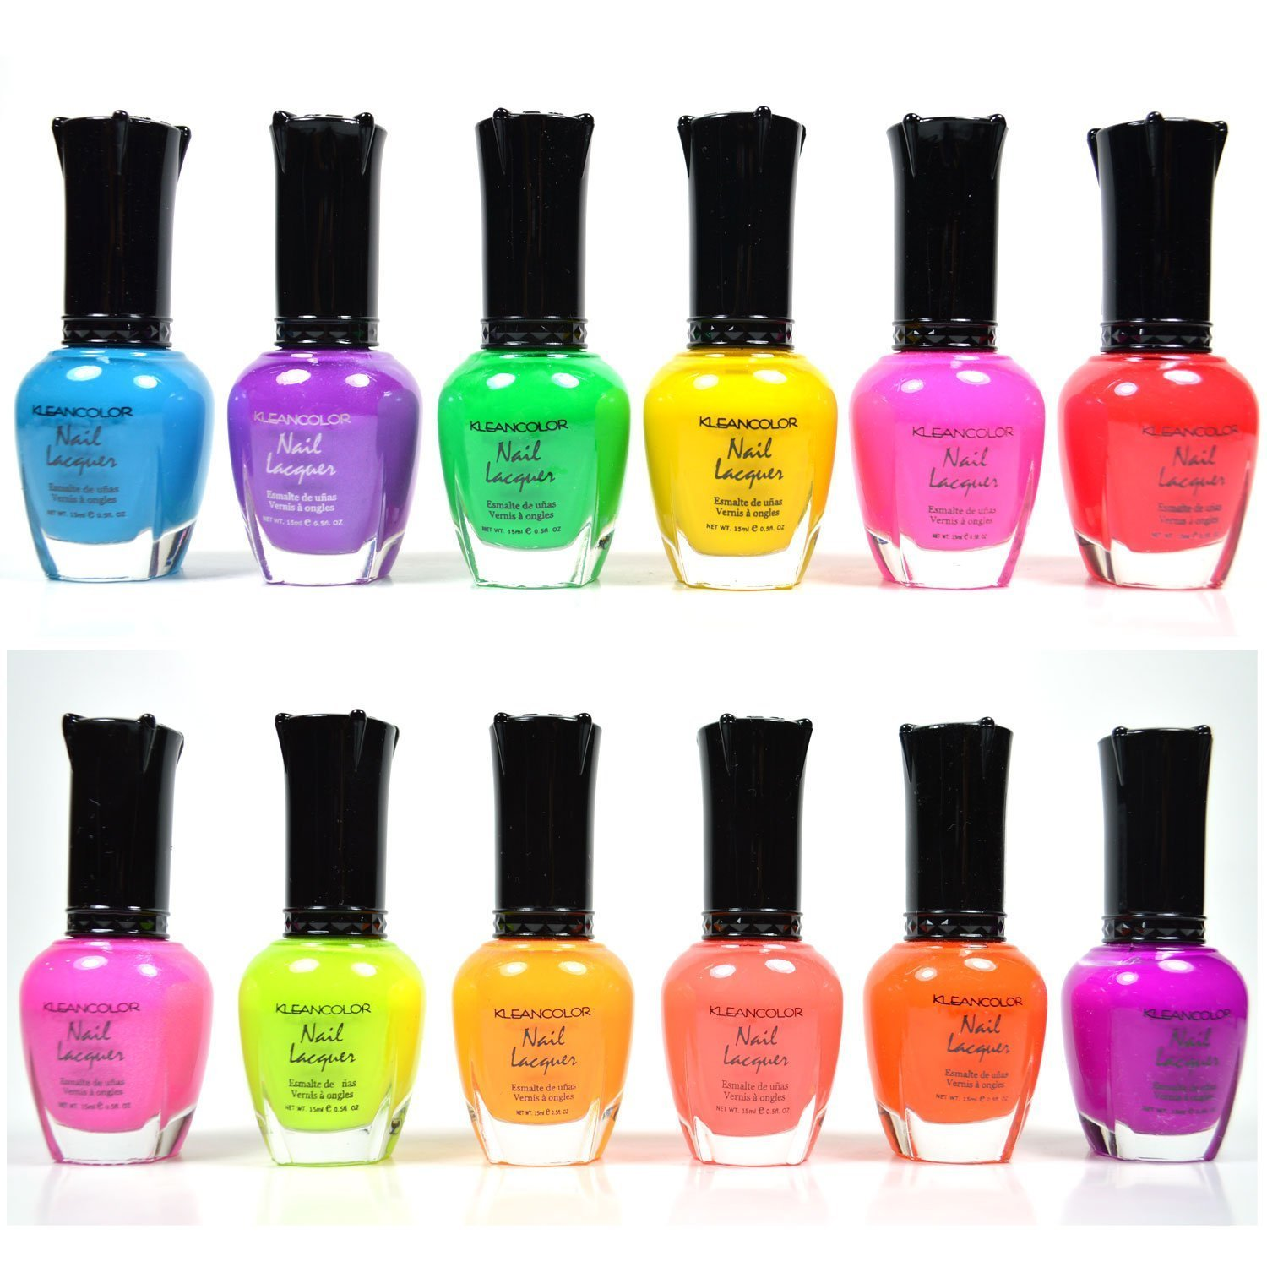
Nail Polish

Slide 4
Crayons

Slide 5
Tree

Slide 6
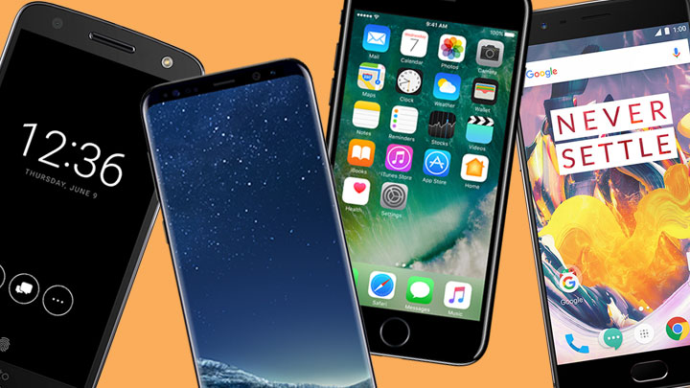
Smartphone

Slide 7
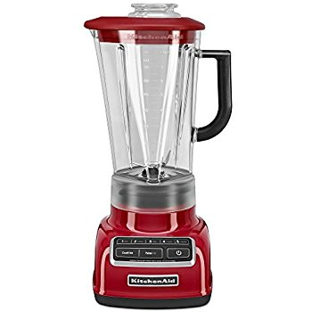
Blender

Slide 8
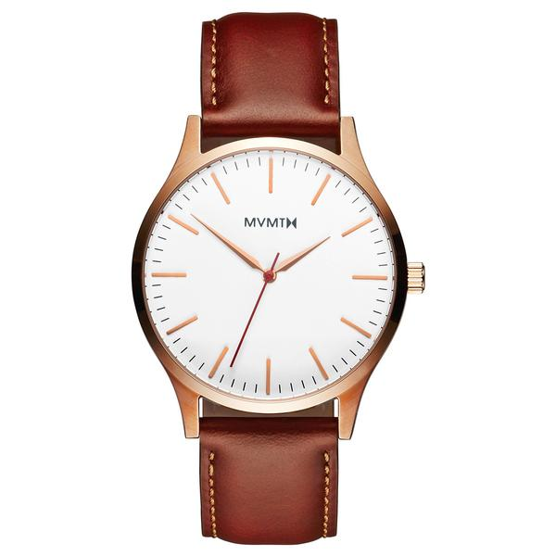
Watch

Slide 9
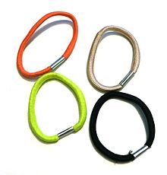
Hair Tie

Slide 10
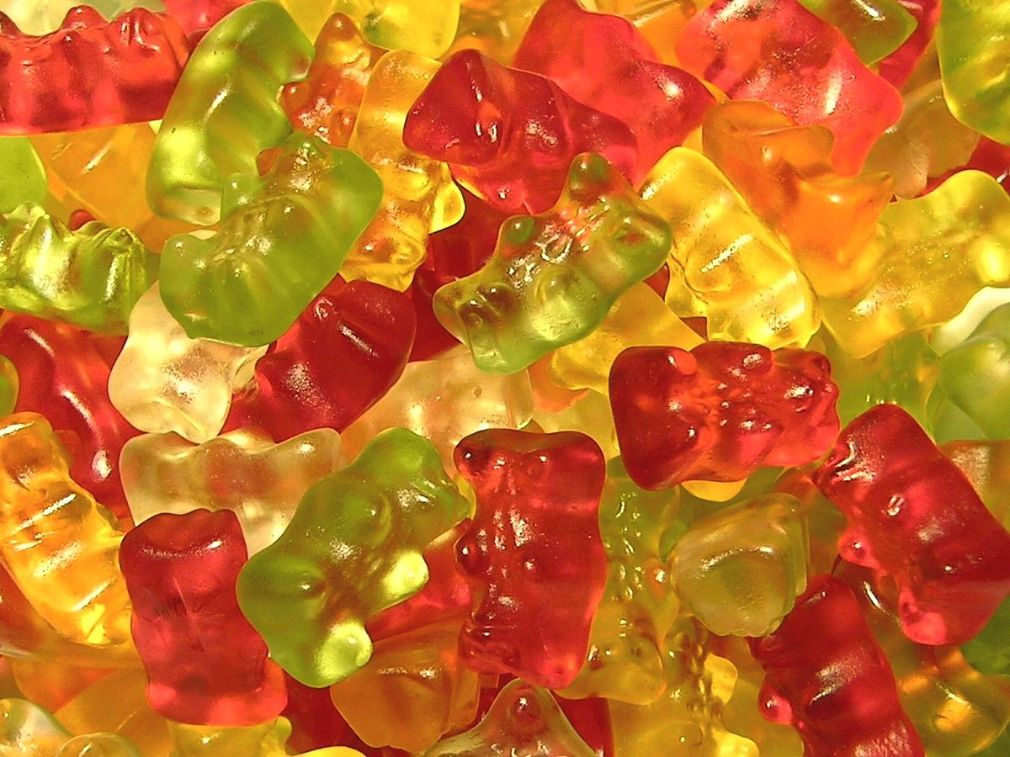
Gummy Bears

Slide 11
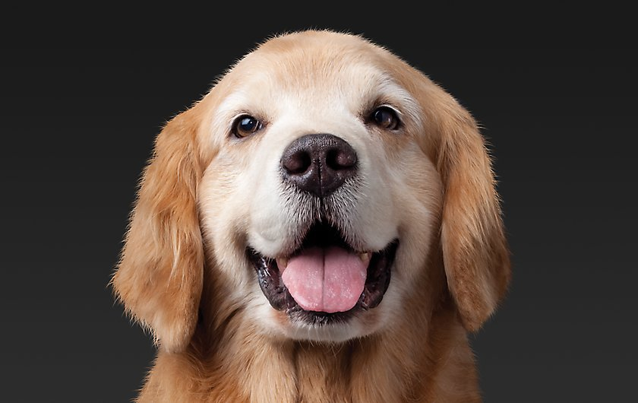
Dog

Slide 12
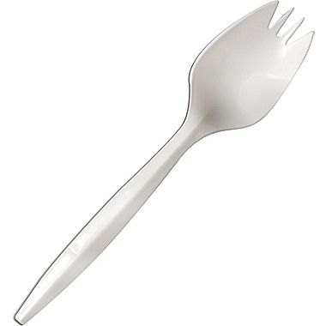
Spork

